Slide 1

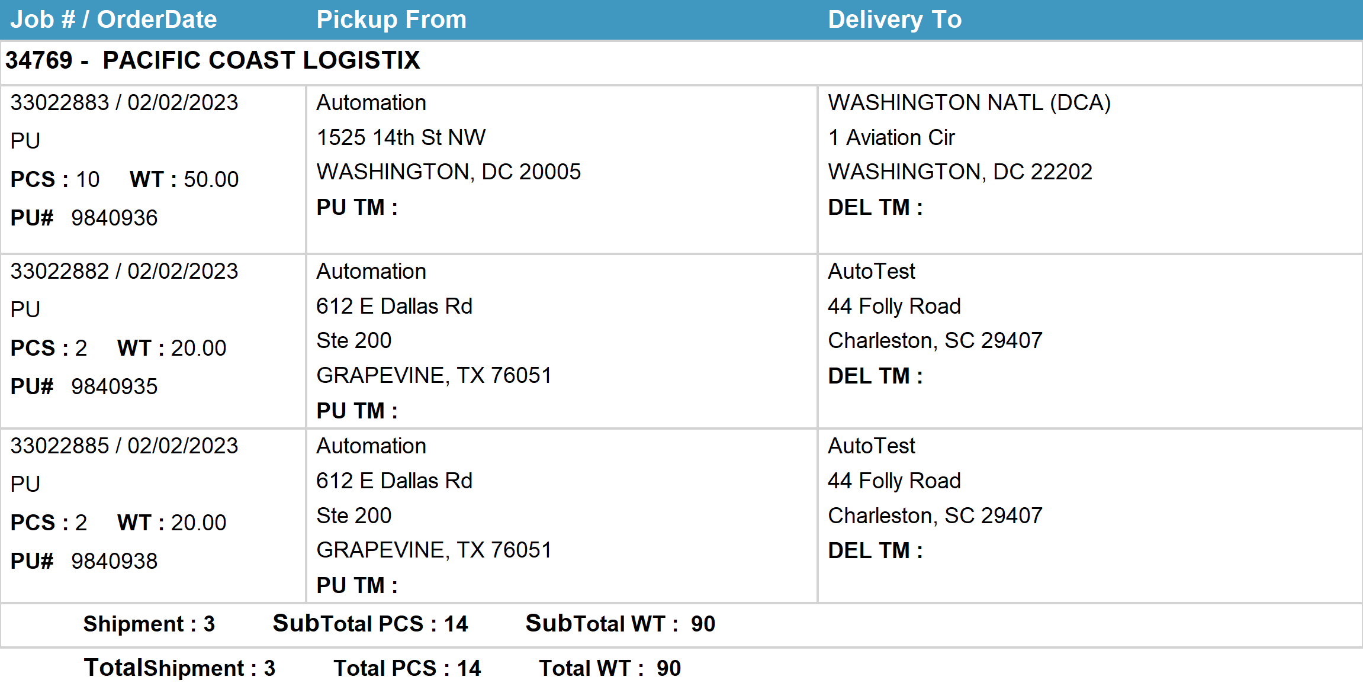
Agent Activity Report
*Data provided should be considered CONFIDENTIAL and PROPRIETARY*
©2011-2023 MNX Global Logistics. All rights reserved.
2/6/2023 5:25 AM
Print User : automation

